Slide 1
Fire Type Pokemon //NASA Space App Challenge
Shuvam Manna
Piyush Maheshwari
Nikhilesh Chandak
Niwesh Gupta

Slide 2

Artemis //When is the Next Rocket Launch?
The Web App Artemis tracks the Schedules of Rocket launches.
Try out the demo at :
artemis010.herokuapp.com

Slide 3

Artemis //When is the Next Rocket Launch?
Lists Rockets to be launched by Public/Private entities.
Enables you to dive into the details by providing additional WebCast links and other information.
Organized information, cleaner and less cluttered than existing services.
artemis010.herokuapp.com

Slide 4
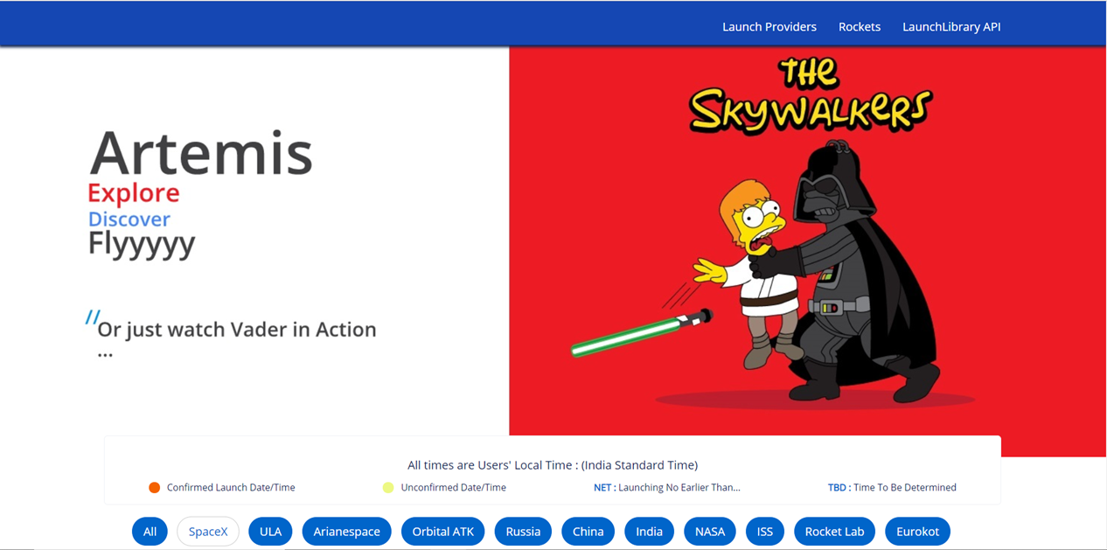

Slide 5
In works //Additional Features in the pipeline
Self-modifying service that orients and customizes itself.
Interactive Games that enables it to double up as a fun app.
PWA-fication.
artemis010.herokuapp.com

Slide 6

Fire Type Pokemon //NASA Space App Challenge
That’s it for this Time.

